Slide 1


KENYA MEDICAL PRACTITIONERS AND DENTISTS COUNCIL
STRUCTURE AND FUNCTION OF
KENYA MEDICAL PRACTITIONERS AND DENTISTS COUNCIL
Friday 4th September 2020
DANIEL YUMBYA, MBS
CHIEF EXECUTIVE OFFICER
KENYA MEDICAL PRACTITIONERS AND DENTISTS COUNCIL

Slide 2
Legal Foundation
Medical Practitioners and Dentists Act Cap. 253.
Enacted in 1977, operational 1st January 1978.
Various amendments and rules
Council’s Mandate is to regulate:
1. Training
2. Practice
3. Licensing
Regulation of Medicine, dentistry, Hospitals, Medical Centers, Clinics
Notes:
The Mandate is to regulate
training,
practice and
licensing of medicine & dentistry, Hospitals, Medical Centre and Clinics

Slide 3
Legal Amendments
Key Amendment Areas
Name of the Body Corporate
Size of the Council
Council Composition
Committees
Functions
Specialist Recognition
Disciplinary
Professional Indemnity
Penalty for unregistered/ unlicensed practitioners
HEALTH LAWS AMENDMENT BILL (2018)
Notes:
The Mandate is to regulate
training,
practice and
licensing of medicine & dentistry, Hospitals, Medical Centre and Clinics

Slide 4
Health Laws Amendment (2019)
PROVISION | PREVIOUS ACT | AMENDMENTS
1. Name of the body corporate | Refers to the established body as a “Board” | Refers to the established body as a “Council” in line with EAC Health Ministers
2. Size of the Board/Council | 17 members | 9 members (In line with Mwongozo)

Slide 5
Health Laws Amendment (2019)
PROVISION | PREVIOUS ACT | AMENDMENTS
3. Composition of the Board/Council | Chairperson DMS DDMS Nominated members University Deans Elected Members | A Chairperson The Director General for Health or a designated representative; Representative of universities in Kenya which have the power to grant a qualification; Representative of the Kenya Medical Association; Representative of Kenya Dental Association; Representative of oral health practitioners; Representative of the Kenya National Commission on Human Rights; Representative of the private sector in health; One person with knowledge and expertise in finance or audit; The Chief Executive Officer who shall be the Registrar and an ex officio member and also the secretary to the Council.

Slide 6
Health Laws Amendment (2019)
4. Committees of the Board/Council | Does not outline the various committees | Outlines the following Committees: Training Assessment Registration & HR Committee Disciplinary & Ethics Committee Inspections, Licensing, Finance Committee Audit & Risk Committee
5. Functions of the Board/Council | Not clearly outlined | A comprehensive list of Council functions to include: regulation of training, registration and licensing of practitioners and institutions and disciplinary proceedings
6. Specialist Recognition | Not provided | Outlined under Sec 11A which clearly defines the period of training and the experience needed for the recognition (Recommendations. by National Assembly-Department Committee on Health)

Slide 7
Health Laws Amendment (2019)
PROVISION | PREVIOUS ACT | AMENDMENT S
7. Disciplinary Proceedings | Focused mostly on convictions Excludes health institutions Sanctions not provided | Clearly outlines who can complain and against who a complaint can be lodged Process of inquiry Sanctions/penalties
8. Professional indemnity | Not provided | Outlined under Sec 15A for both practitioners and health institutions (Recommendations. by National Assembly-Department Committee on Health)
9. Penalty for unregistered & unlicensed persons practicing | Kshs. 10,000.00 or 12months jail term | Kshs. 5,000,000.00 or 5 year jail term as deterrent measures

Slide 8
Secretariat
Registration & Licensing
IT
Human Resources
Finance
Procurement
Compliance
Legal Services
Administration
The Secretariat is headed by the Chief Executive Officer and comprises of 8 Functional Departments
Notes:
The Mandate is to regulate
training,
practice and
licensing of medicine & dentistry, Hospitals, Medical Centre and Clinics

Slide 9
Committees
Standing Committees
Training, Assessment & Human Resource Committee
Disciplinary & Ethics Committee
Inspections, Licensing, Finance & General Purpose Committee
Audit & Risk Committee
Ad Hoc Committees
Professional Conduct Committee
Fitness to Practice Committee
Notes:
Standing Committees:
Training, Assessment & Human Resource Committee
Disciplinary & Ethics Committee
Inspections, Licensing, Finance & General Purpose Committee
Audit & Risk Committee
Ad Hoc Committees
Professional Conduct Committee
Fitness to Practice Committee

Slide 10
Functions
Establish and maintain uniform norms and standards on the learning of medicine and dentistry in Kenya
Approve and register medical and dental schools for training of medical and dental practitioners.
Prescribe the minimum educational entry requirements for persons wishing to be trained as medical and dental practitioners.
Maintain a record of medical and dental students.
Internship qualifying examinations, preregistration examinations, and peer reviews as deemed appropriate by the Council
Notes:
Education & Training: Approval of Medical & Dental Schools, Core Curricula, Conduct Examination and CPD
Registration: Medical, Dental practitioners and Health Institutions
Licensing :Medical & Dental Practitioners, Foreign Doctors, Health Institutions
Inspections: Medical/ Dentals Schools, Internship Centers, Health facilities
Disciplinary: Preliminary Inquiry Committee (National), Professional Conduct Committee (County) and Tribunal(National)

Slide 11
Functions
Inspect and accredit new and existing institutions for medical and dental internship training in Kenya
License eligible medical and dental interns
Determine and set a framework for professional practice of medical and dental practitioners.
Regulate the conduct of registered medical and dental practitioners and take such disciplinary measures for any form of professional misconduct.

Slide 12
Functions
Register eligible medical and dental practitioners.
Register eligible medical and dental practitioners.
Register and license health institutions.
Carry out inspection of health institutions

Slide 13
Functions
Regulate health institutions and take disciplinary action for any form of misconduct by a health institution.
Accredit continuous professional development providers.
Issue certificate of status to medical and dental practitioners and health institutions.
Do all such other things necessary for the attainment of all or any part of its functions.

Slide 14
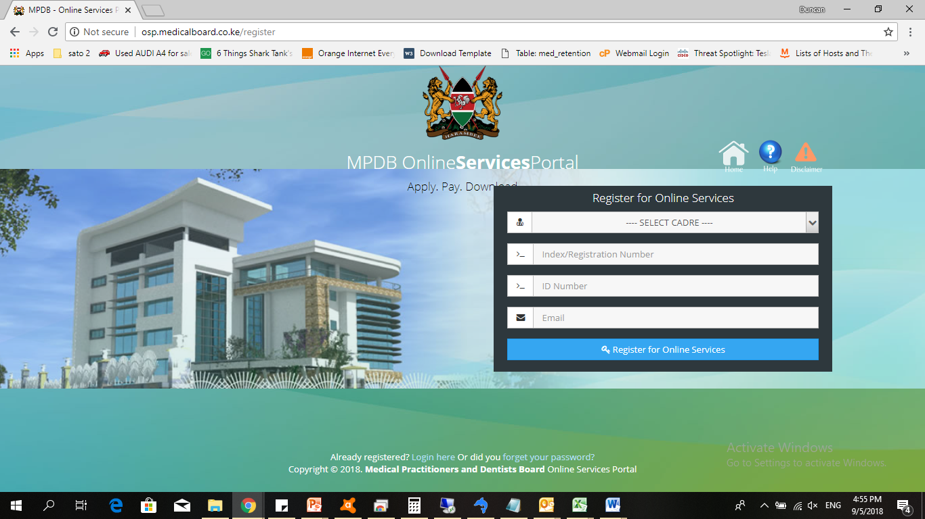
COUNCIL’S ONLINE SERVICES
Online application for renewal of Doctors’ General Practice & Specialist License: osp.kmpdc.co.ke
Online application for renewal of Health Institution license: osp.kmpdc.co.ke
Integrated CPD Management System (ICMS)
www.icpdkenya.org
Publications
Online release of Exams for Foreign Trained Doctors
Registers for licensed doctors and health institutions

Slide 15
COUNCIL’S ONLINE SERVICES PORTAL
For Doctors
Renewal of General Practice License
Renewal of Registrar Practice License
Renewal of Senior Registrar Practice License
Renewal of Specialist Practice License
Renewal of Temporary Licenses for Foreign Doctors
For Health Facilities
Renewal of Health Facility License
Reporting of Health Facility Inspection

Slide 16
Publications
RULES
Medical Institutions) (Amendment) Rules, 2017
(Referral of Patients Abroad) Rules, 2017
(Professional Fees) Rules, 2016
(Practitioners and Health Facilities, Advertising) Rules,2016
(Medical Camp) Rules, 2016
(Fitness to Practice) Rules, 2016

Slide 17
Service Delivery; Achievements
Publications
STANDARDS
National Training & Quality Assurance Standards for Dental, Medical Schools & Teaching Hospitals in Kenya.
CURRICULA
Bachelor of Medicine Core Curriculum
Bachelor of Dental Surgery Core Curriculum
Fees Guidelines, 3rd Edition 2013 (reviewed 2016)
Legal notice, Professional fees rules 2016
Code of Professional Conduct and Discipline, 6th Edition

Slide 18
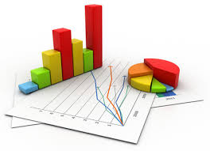
Health Statistics
Health Information
Notes:
The Mandate is to regulate
training,
practice and
licensing of medicine & dentistry, Hospitals, Medical Centre and Clinics

Slide 19
Practitioners Status in Kenya
Total Medical & Dental practitioners REGISTERED since 1978
Medical – 12,864
Dental – 1,347
Total number of practitioners licensed for 2020 (Kenyans and foreigners)
Medical – 8469
Dental - 828
As at 17th August 2020

Slide 20
Registered Training Institutions, 2020
As at 17th August 2020
Notes:
List of Approved schools

Slide 21
REGISTRATION/LICENSE STATUS
Doctors in Private Practice
Medical and Dental Specialists | Medical | 2,257
 | Dental | 117
Medical Schools in Kenya |  | 11
Dental Schools in Kenya |  | 2
Medical Schools in EAC |  | 26
Dental Schools in EAC |  | 5
Medical Officers Interns |  | 693
Dental Officers Interns |  | 70
Internship Training Centers | Medical | 79
 | Dental | 9
Specialist Recognition Training Centres |  | 2
Post graduate Teaching Hospitals |  | 4
Health Institutions (Various categories) | Registered | 13,580
 | Active (2020) | 5,325
As at 17th August 2020
Notes:
List of Approved schools

Slide 22
World Health Organization Recommended Doctor to Population Ratio
Population of Kenya 48,000,000
WHO recommended Ratios
Current Ratios in Kenya
1 doctor per 1,000 population by 2015
1 doctor per 600 population by 2020
1 Medical doctor per 3,672
(Registered Practitioners = 13,073)
1 Dental doctor 35,165
(Registered Practitioners = 1,365)
1 Medical doctor per 5,668
(Licensed Practitioners = 8,469)
1 Dental Practitioner per 57,971
(Licensed Practitioners = 828

Slide 23

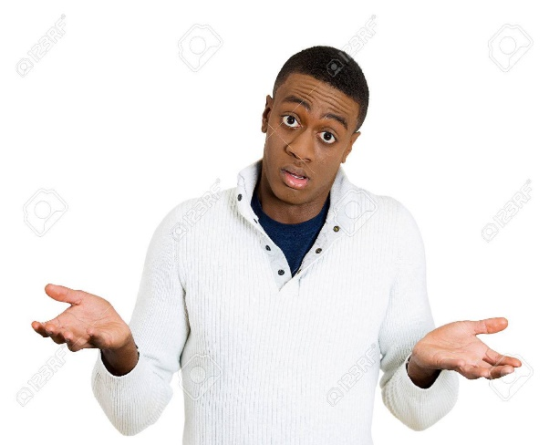

What kind of doctor do we need?
Notes:
What's a good doctor and how do you make one?
Doctors should be good companions for people
Respect people, healthy or ill, regardless of who they are
Support patients and their loved ones when and where they are needed
Promote health as well as treat disease
Embrace the power of information and communication technologies to support people with the best available information, while respecting their individual values and preferences
Always ask courteous questions, let people talk, and listen to them carefully
Give unbiased advice, let people participate actively in all decisions related to their health and health care, assess each situation carefully, and help whatever the situation
Use evidence as a tool, not as a determinant of practice; humbly accept death as an important part of life; and help people make the best possible arrangements when death is close
Work cooperatively with other members of the healthcare team
Be proactive advocates for their patients, mentors for other health professionals, and ready to learn from others, regardless of their age, role, or status
Finally, we want doctors to have a balanced life and to care for themselves and their families as well as for others. In sum, we want doctors to be happy and healthy, caring and competent, and good travel companions for people through the journey we call life.

Slide 24

World Health Organization (WHO)
Ideal Profile of a doctor
WHO Five Star Doctor
Ideal doctors profile
Five Star Doctor
Care Provider
Decision maker
Communicator
Community Leader
Manager
Scientist
Practitioner
Professional
Leader & Manager
Notes:
WHO five star doctor (Care giver, Decision maker, Communicator, Leader and Manager)
The concept of the “five-star doctor” is proposed as an ideal profile of a doctor possessing a mix of aptitudes to carry out the range of services that health settings must deliver to meet the requirements of relevance, quality, cost-effectiveness and equity in health

Slide 25
COMPETENCES
Keen on continuous training(CPD)
Medical and scientific knowledge
Clinical skills and Patient care
Interpersonal & Communication skills
Professionalism
The Ideal Doctor will possess a mix of aptitudes to carry out the range of services that health settings must deliver, to meet the requirements of relevance, quality, cost-effectiveness and equity in health
Notes:
Keen on continuous training(CPD)
Medical and scientific knowledge
Clinical skills and Patient care
Professionalism
Interpersonal and communication skills
Management and

Slide 26
THE DOCTOR THAT WE NEED
.
Clinical competence and skills
Knowledgeable and understanding
Takes proper patient notes
Good communicator - asking and listening
Available
Notes:
Clinical competence and skills
Knowledgeable and understanding
Takes proper patient notes
Good communicator - asking and listening
Available

Slide 27
THE DOCTOR THAT WE NEED
.
Integrity and accountability
Caring and respectful
Promotes health as well as treat diseases
Embrace power of ICT
Innovative
Team player
Notes:
Integrity and accountability
Caring and respectful
Promotes health as well as treat diseases
Embrace power of ICT
Innovative
Team player

Slide 28
FACTORS INHIBITING THE MAKING OF THE
DOCTOR THAT WE NEED
Medical and dental training
Inadequate equipment and medical personnel
Dual –practice (government and private practice)
Changing mindset from curative services to disease prevention and health promotion
Migration of doctors for various reasons
Inadequate distribution of doctors in counties
Inadequate specialists
Task-shifting
Notes:
Medical and dental training
Inadequate equipment and medical personnel
Dual –practice (government and private practice)
Changing mindset from curative services to disease prevention and health promotion
Migration of doctors for various reasons
Inadequate distribution of doctors in counties
Insufficient specialists
Task-shifting

Slide 29
How do we make a good doctor?
HOW DO WE GET THAT DOCTOR?
Training
General aim is to produce quality graduates that will provide quality and safe health care and is accountable to the population.
The curriculum is described as competency based providing the graduate with knowledge, skills to complete specific workplace actions at a given standard over a wide range of situation and environment
Notes:
Compassion. Physicians aren't robots. ...
Strong Work Ethic. Having a strong work ethic means you dedicate 100% of yourself to your work every day, regardless of how tired you are or what is going on in your personal life. ...
Professionalism. ...
Knowledge. ...
Confidence. ...
Humility. ...
Passion.

Slide 30
How do we get a good doctor?
Institutional policies and legislation
Mutual Recognition Agreements and Reciprocal Registration
Harmonization and development of BDS and Core-Curricula for the EAC Partner States Training Schools
Joint Inspection of Medical and dental schools
EAC Common Markets Protocol on free movement of goods and services
Guidelines for Internship training
Establishment of Professional Colleges

Slide 31
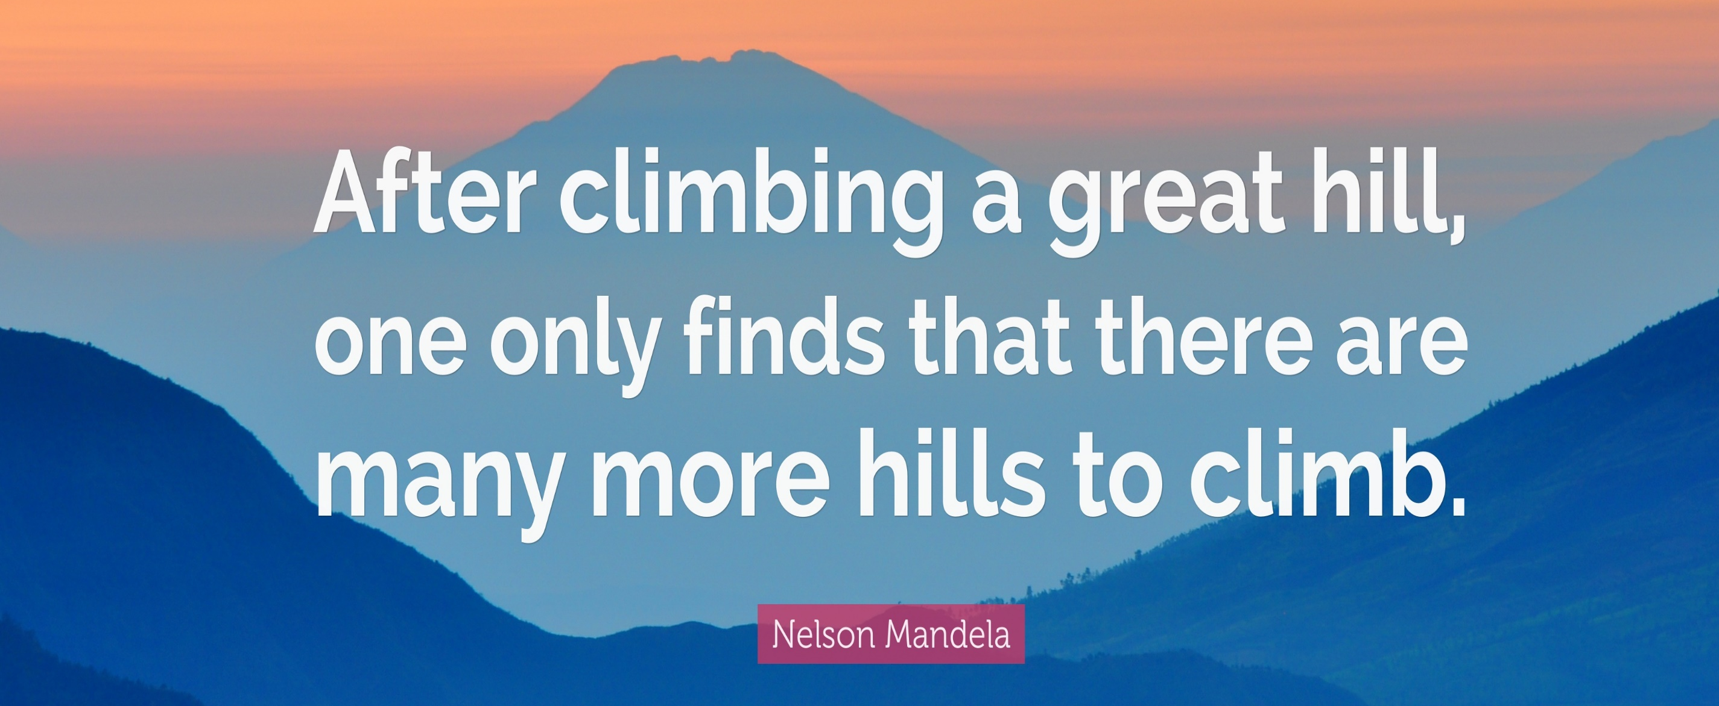

Slide 32
CONTACT DETAILS
KMPDC Complex,
P.O Box 44839-00100
Nairobi
Hurlingham
Woodlands Rd, off Lenana Rd
Telephone: 020 2724994, 2728752, 2711478
Mobile: +254 720 771 478, +254 738 504 112
Email: ceo@kmpdc.go.ke
info@kmpdc.go.ke
Website: www.kmpdc.go.ke

